Slide 1
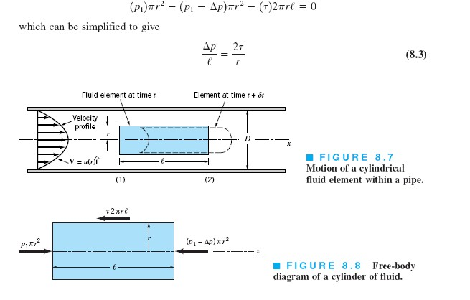
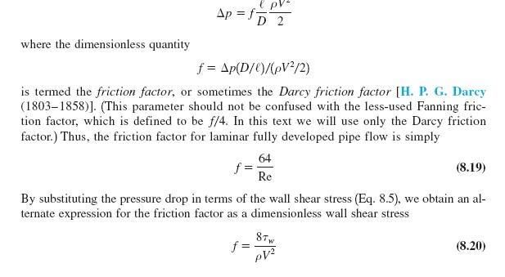


Fluid Mechanics Class Note
Dr. Qassem Hamed Jalut Associate Professor
Flow in pipes
Laminar flow for real fluid
112

Slide 2
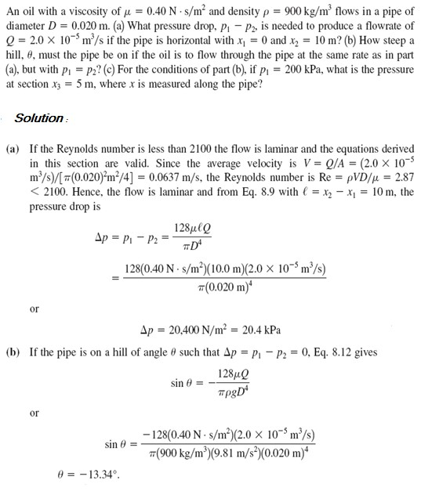
Fluid Mechanics Class Note
Dr. Qassem Hamed Jalut Associate Professor
Problem (1) pipe flow for real fluid

Slide 3
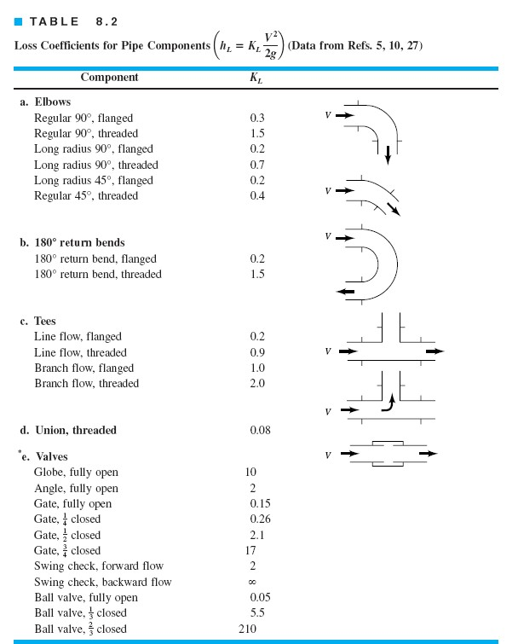
Fluid Mechanics Class Note
Dr. Qassem Hamed Jalut Associate Professor

Slide 4
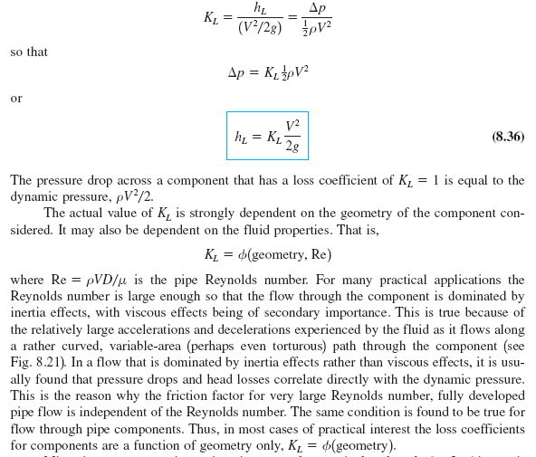
Fluid Mechanics Class Note
Dr. Qassem Hamed Jalut Associate Professor
Minor losses:
The most common method used to determine these head losses or pressure drops is to specify the loss coefficient, K_{L} which is defined as

Slide 5
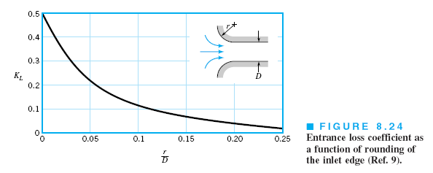
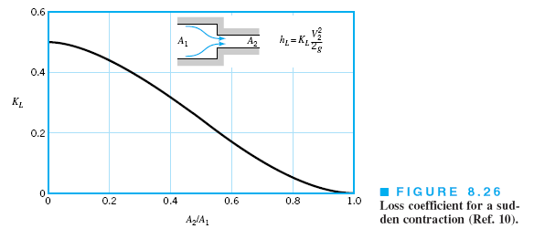
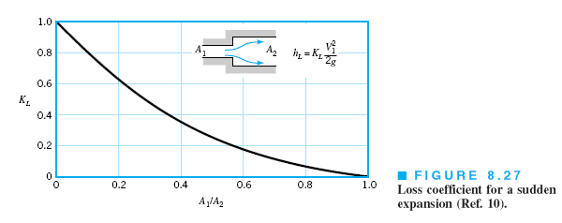
Fluid Mechanics Class Note
Dr. Qassem Hamed Jalut Associate Professor

Slide 6
Fluid Mechanics Class Note
Dr. Qassem Hamed Jalut Associate Professor

Slide 7
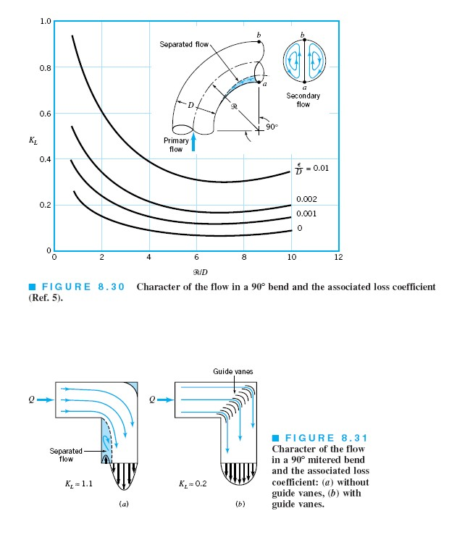
Fluid Mechanics Class Note
Dr. Qassem Hamed Jalut Associate Professor

Slide 8
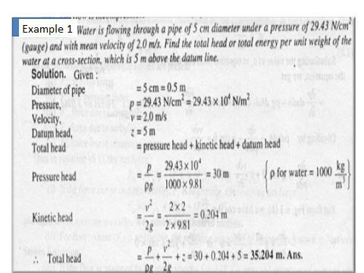
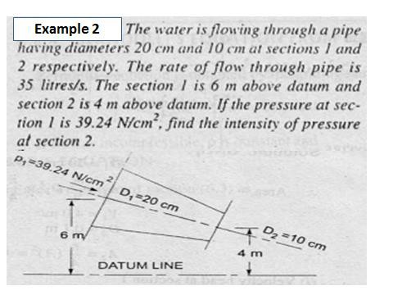
Fluid Mechanics Class Note
Dr. Qassem Hamed Jalut Associate Professor

Slide 9
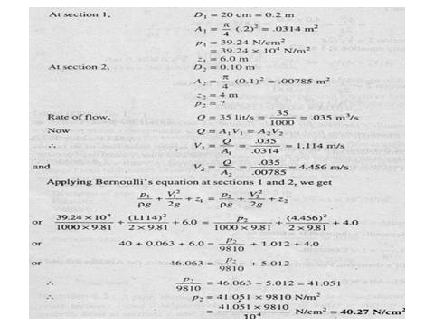
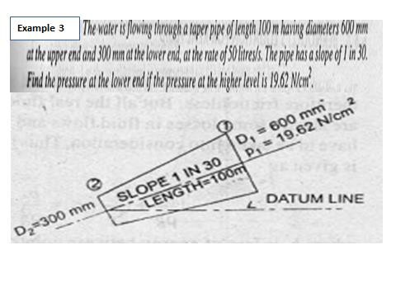
Fluid Mechanics Class Note
Dr. Qassem Hamed Jalut Associate Professor
120

Slide 10
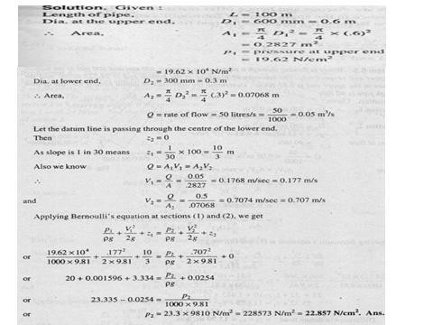
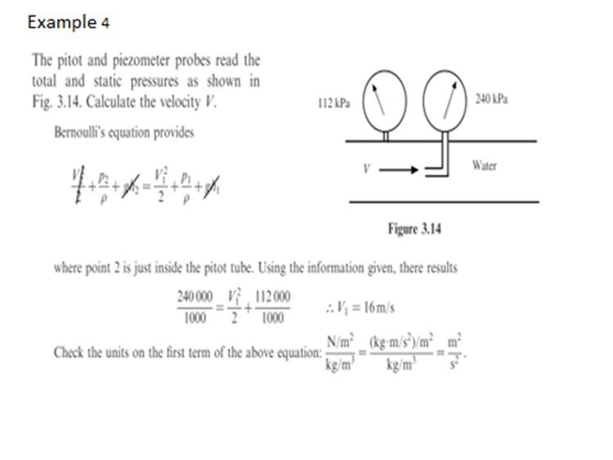
Fluid Mechanics Class Note
Dr. Qassem Hamed Jalut Associate Professor
Application of Bernolli Equations

Slide 11
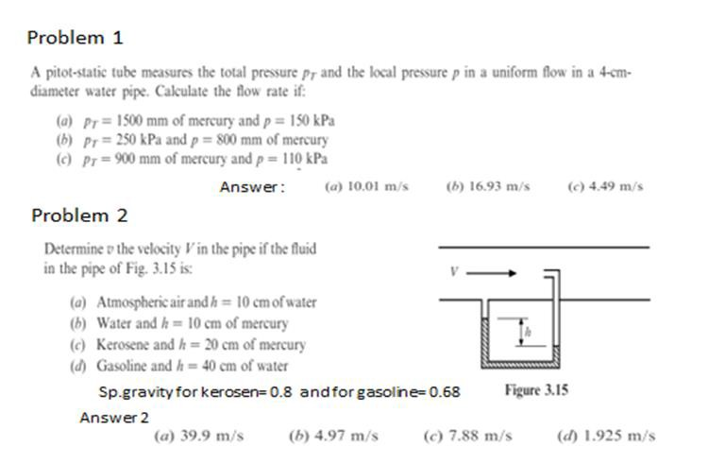
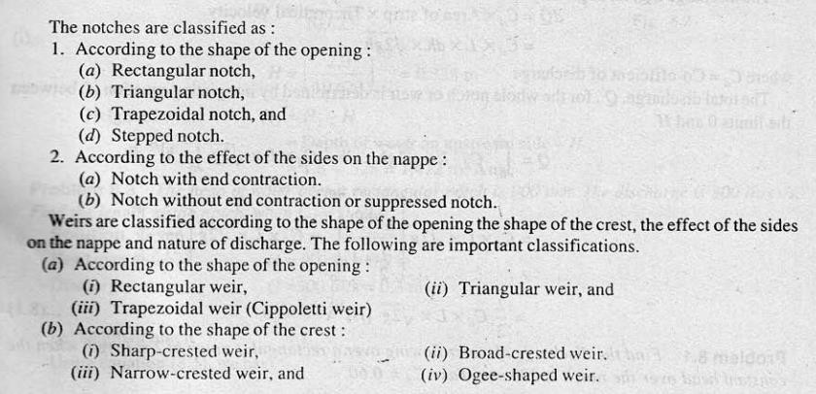
Fluid Mechanics Class Note
Dr. Qassem Hamed Jalut Associate Professor
Weirs

Slide 12
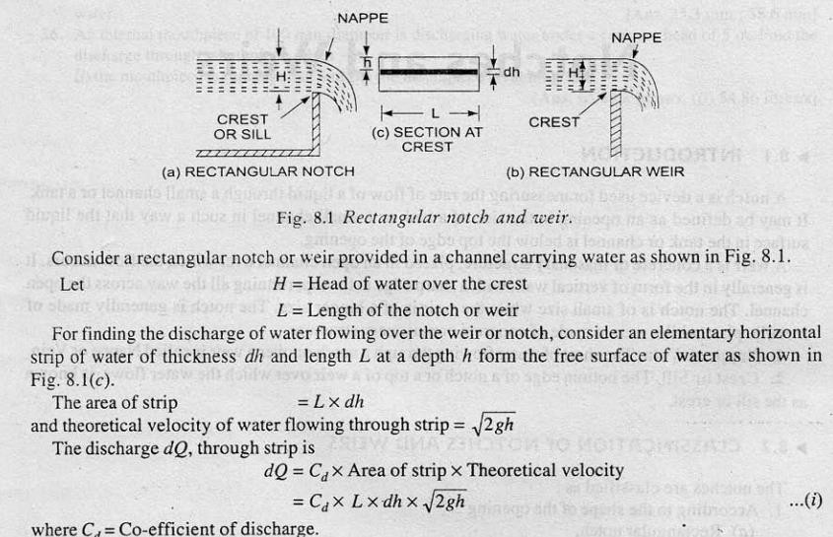
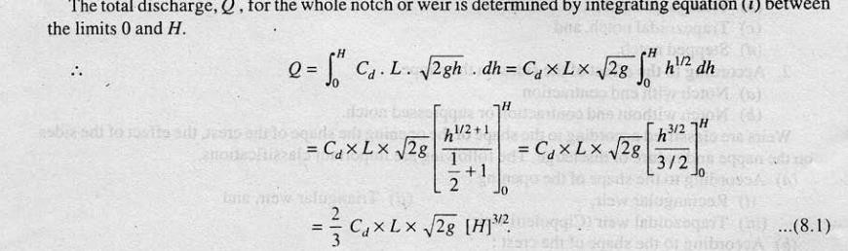
Fluid Mechanics Class Note
Dr. Qassem Hamed Jalut Associate Professor
Problem 1:

Slide 13
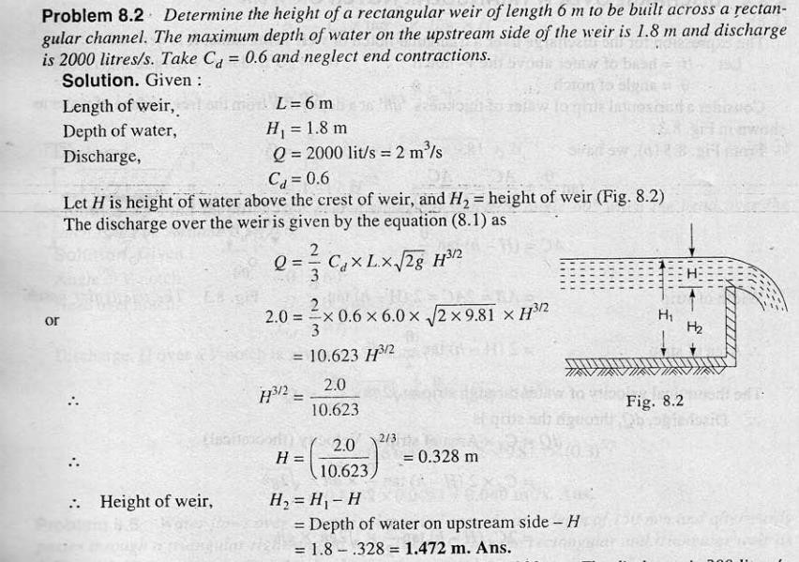
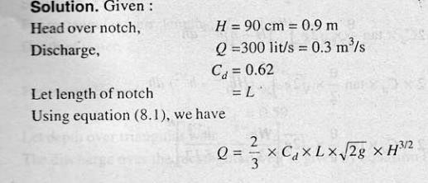
Fluid Mechanics Class Note
Dr. Qassem Hamed Jalut Associate Professor
Problem

Slide 14
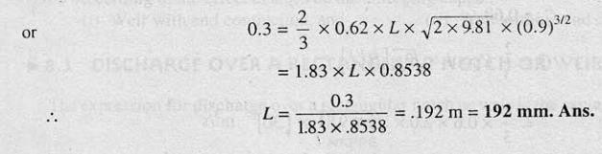
Fluid Mechanics Class Note
Dr. Qassem Hamed Jalut Associate Professor

Slide 15
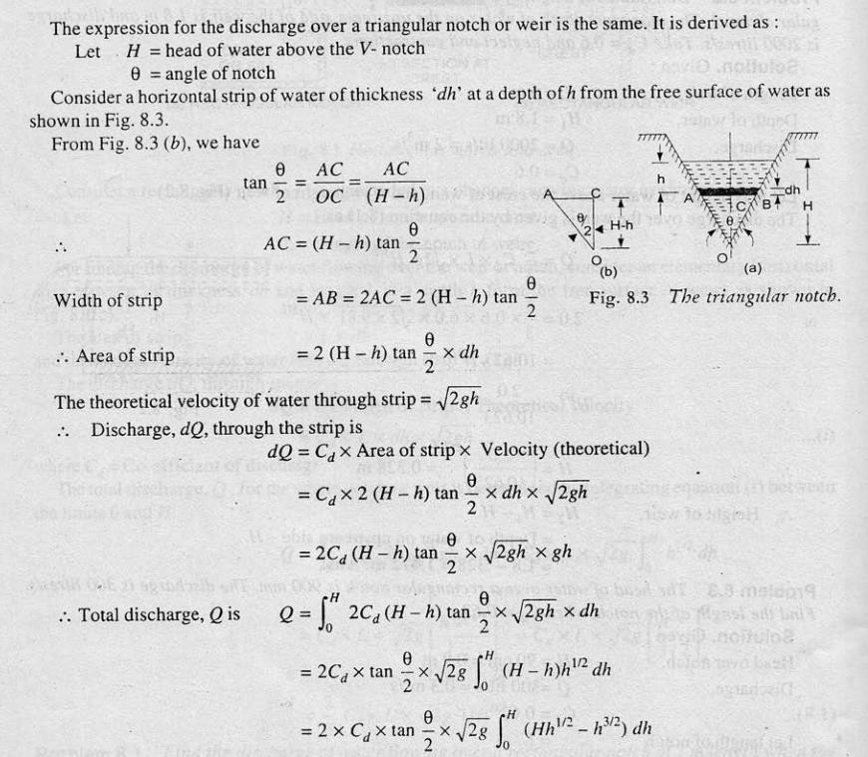
Fluid Mechanics Class Note
Dr. Qassem Hamed Jalut Associate Professor

Slide 16
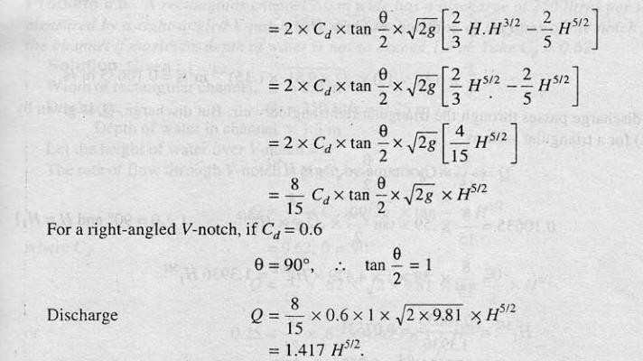
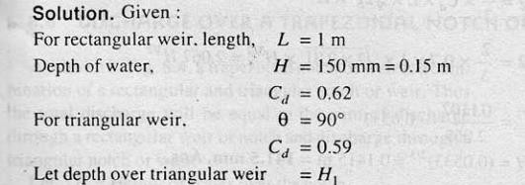
Fluid Mechanics Class Note
Dr. Qassem Hamed Jalut Associate Professor
Problem 3:

Slide 17
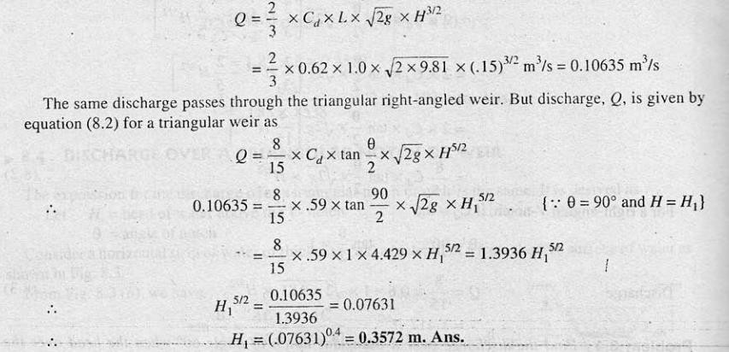
Fluid Mechanics Class Note
Dr. Qassem Hamed Jalut Associate Professor
Stepped Notch

Slide 18
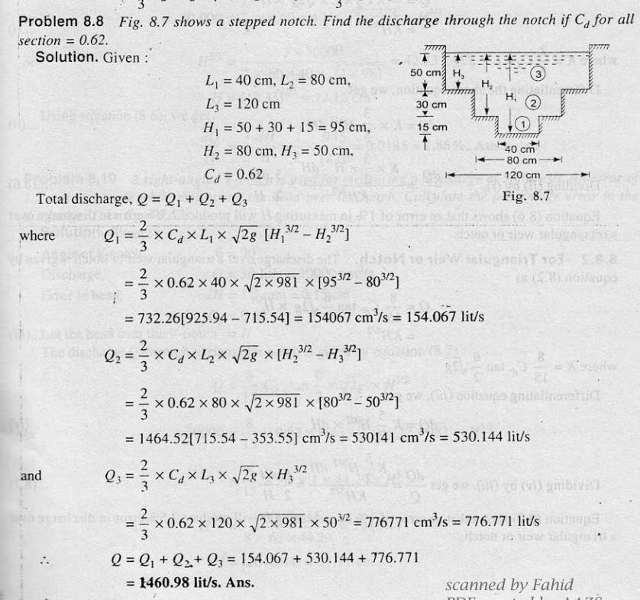
Fluid Mechanics Class Note
Dr. Qassem Hamed Jalut Associate Professor
Friction Factor Calculations
The Darcy-Weisbach equation, for calculating the friction loss in a pipe, uses a dimensionless value known as the friction factor (also known as the Darcy-Weisbach

Slide 19
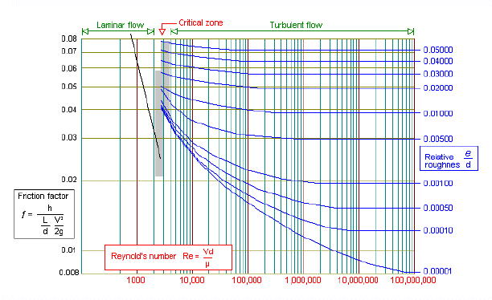
Fluid Mechanics Class Note
Dr. Qassem Hamed Jalut Associate Professor
friction factor or the Moody friction factor) and it is four times larger than the Fanning friction factor.
Friction Factor Chart / Moody Chart
The friction factor or Moody chart is the plot of the relative roughness (e/D) of a pipe against the Reynold's number. The blue lines plot the friction factor for flow in the wholly turbulent region of the chart, while the straight black line plots the friction factor for flow in the wholly laminar region of the chart.
In 1944, LF Moody plotted the data from the Colebrook equation and the resulting chart became known asThe Moody Chart or sometimes the Friction Factor Chart. It was this chart which first enabled the user to obtain a reasonably accurate friction factor for turbulent flow conditions, based on the Reynolds number and the Relative Roughness of the pipe.
Friction Factor for Laminar Flow
The friction factor for laminar flow is calculated by dividing 64 by the Reynold's number.
Friction factor (for laminar flow) = 64 / Re
Critical Flow Condition
When flow occurs between the Laminar and Turbulent flow conditions (Re 2300 to Re 4000) the flow condition is known as critical and is difficult to predict. Here the flow is neither wholly laminar nor wholly turbulent. It is a combination of the two flow conditions.

Slide 20

Fluid Mechanics Class Note
Dr. Qassem Hamed Jalut Associate Professor
Friction Factor for Turbulent Flow
The friction factor for turbulent flow is calculated using the Colebrook-White equation:
Colebrook-White Equation
Due to the implicit formation of the Colebrook-White equation, calculation of the friction factor requires an iterative solution via numerical methods.
The friction factor is then used in the Darcy-Weisbach formula to calculate the fluid frictional loss in a pipe.
SI based Moody Diagram
The Moody friction factor - λ (or f) - is used in the Darcy-Weisbach major loss equation. The coefficient can be estimated with the diagram below:

Slide 21
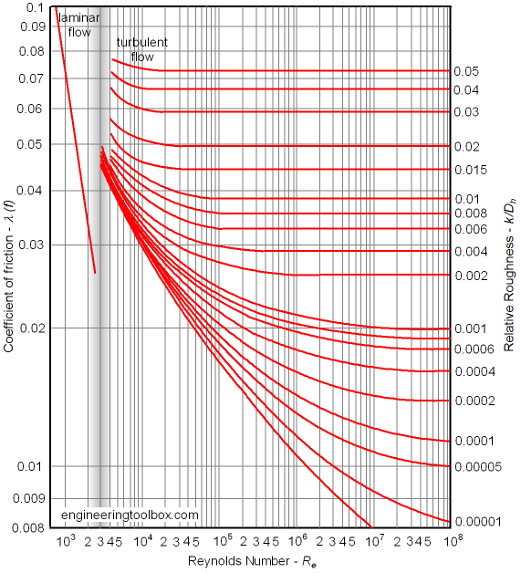
Fluid Mechanics Class Note
Dr. Qassem Hamed Jalut Associate Professor
If the flow is transient - 2300 < Re < 4000 - the flow varies between laminar and turbulent flow and the friction coefiicient is not possible to determine. The friction factor can usually be interpolated between the laminar value atRe = 2300 and the turbulent value at Re = 4000.
Example - SI based Friction Factor
For a PVC pipe with absolute roughness k = 0.0015 10⁻³ (m), hydraulic diameter D_{h} = 0.1
(m) and Reynolds number Re = 10⁷ - the relative rougness can be calculated as
k/R_{h} = (0.0015 10⁻³ m) / (0.02 m)
= 0.000075
From the diagram above, with the relative rougness and the Reynolds number - the friction factor can be estimated to aprox. 0.011.

Slide 22
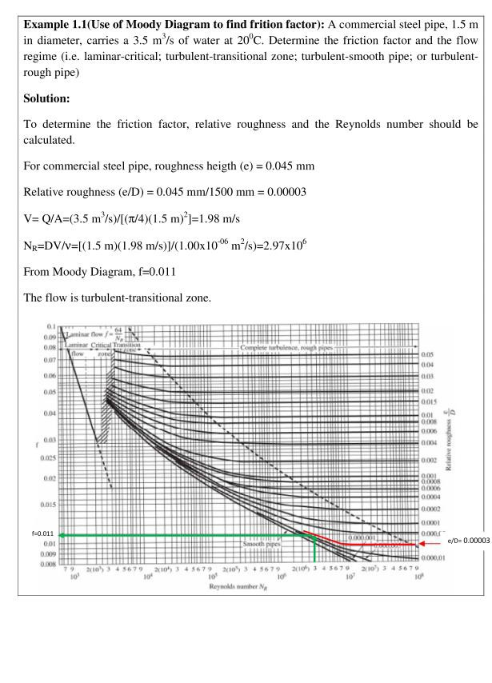
Fluid Mechanics Class Note
Dr. Qassem Hamed Jalut Associate Professor

Slide 23
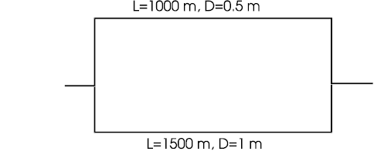
Fluid Mechanics Class Note
Dr. Qassem Hamed Jalut Associate Professor
Ex : (1)
A piping system consists of parallel pipes as shown in the following diagram.E One pipe has an internal diameter of 0.5 m and is 1000 m long. The other pipe has an internal diameter of 1 m and is 1500 m long. Both pipes are made of cast iron (ks = 0.26 mm). The pipes are transporting water at 20oC (ρ = 1000 kg/m3, ν = 10−6 m2/s). The total flow rate is 4 m3/s. Find the flow rate in each pipe and the pressure drop in the system. There is no elevation change. Neglect minor losses.

Slide 24
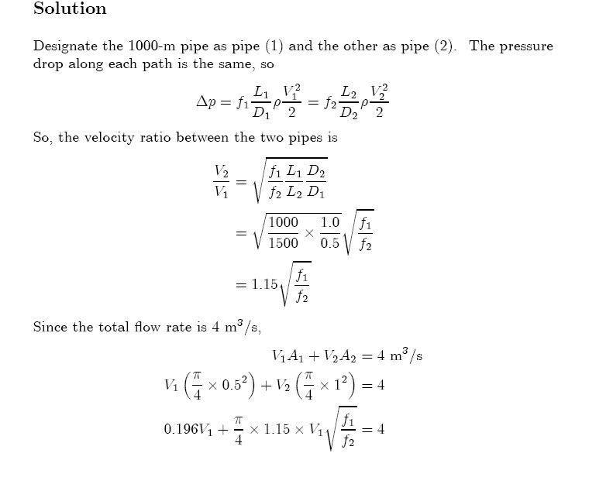
Fluid Mechanics Class Note
Dr. Qassem Hamed Jalut Associate Professor

Slide 25
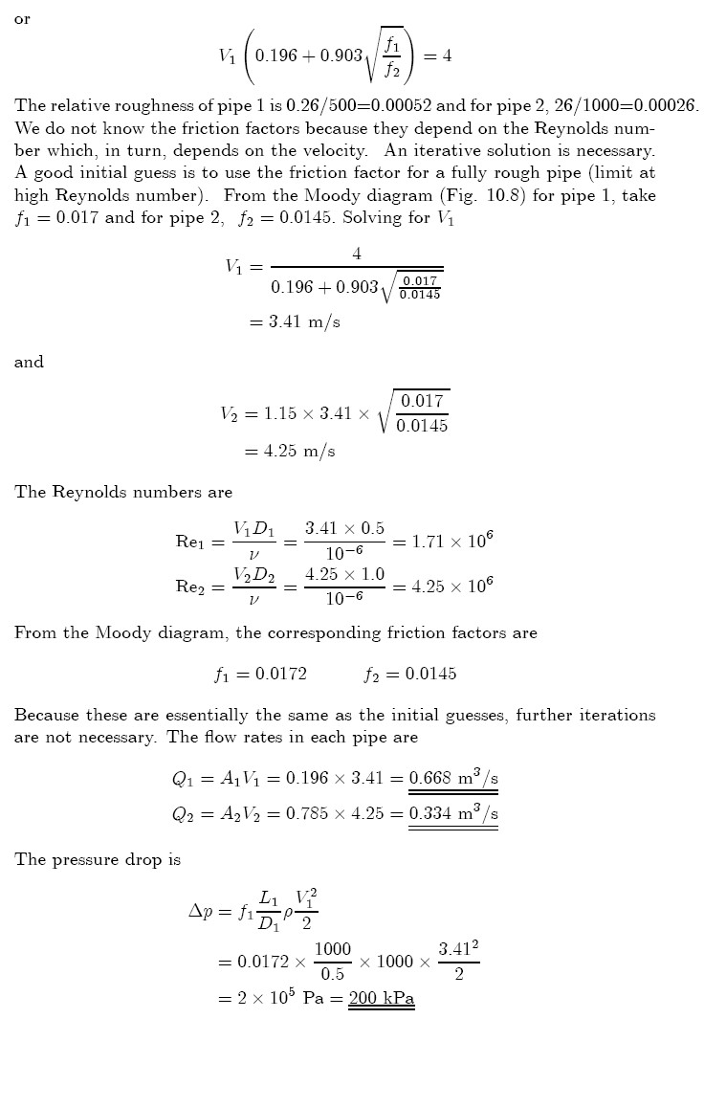
Fluid Mechanics Class Note
Dr. Qassem Hamed Jalut Associate Professor

Slide 26
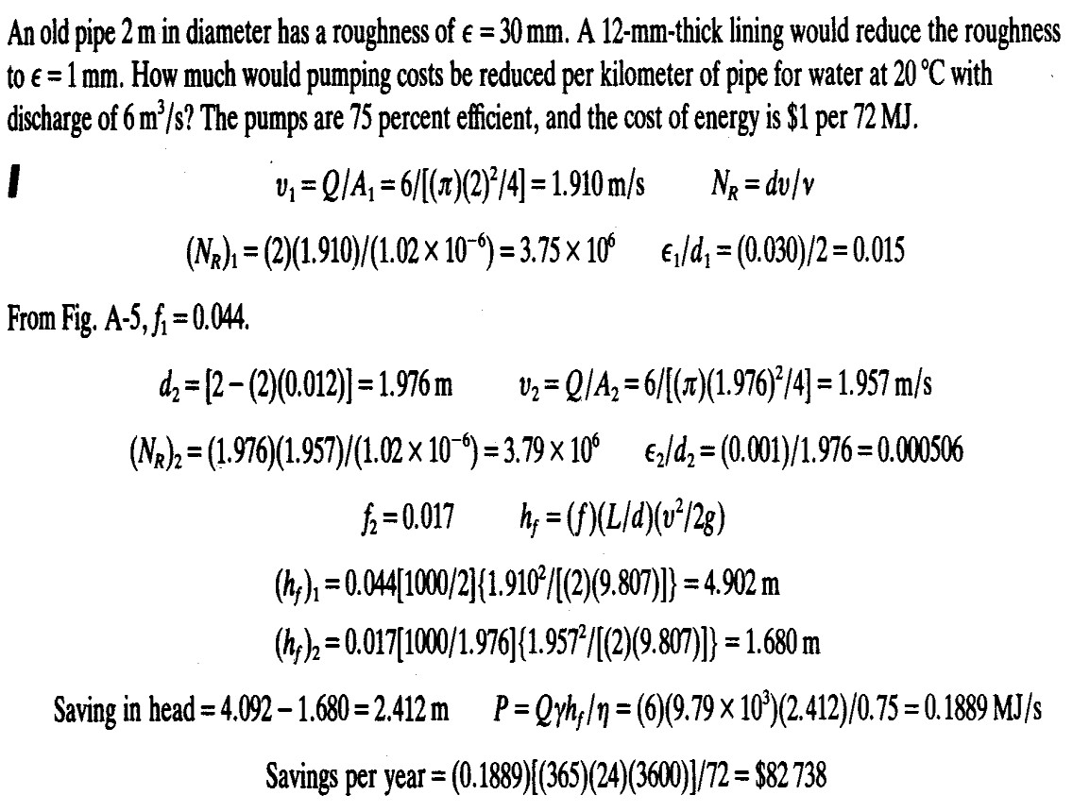
Fluid Mechanics Class Note
Dr. Qassem Hamed Jalut Associate Professor
Ex:(2)

Slide 27
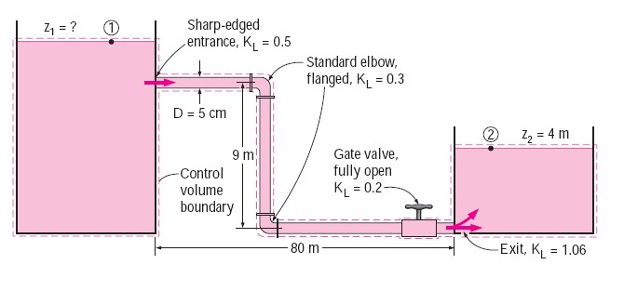
Fluid Mechanics Class Note
Dr. Qassem Hamed Jalut Associate Professor
EXAMPLE 1: Gravity-Driven Water Flow in a Pipe
Water at 10°C flows from a large reservoir to a smaller one through a 5- cmdiameter cast iron piping system, as shown in Fig. below. Determine the elevation z1 for a flow rate of 6 L/s.
Note : Vº= Q = flow rate

Slide 28
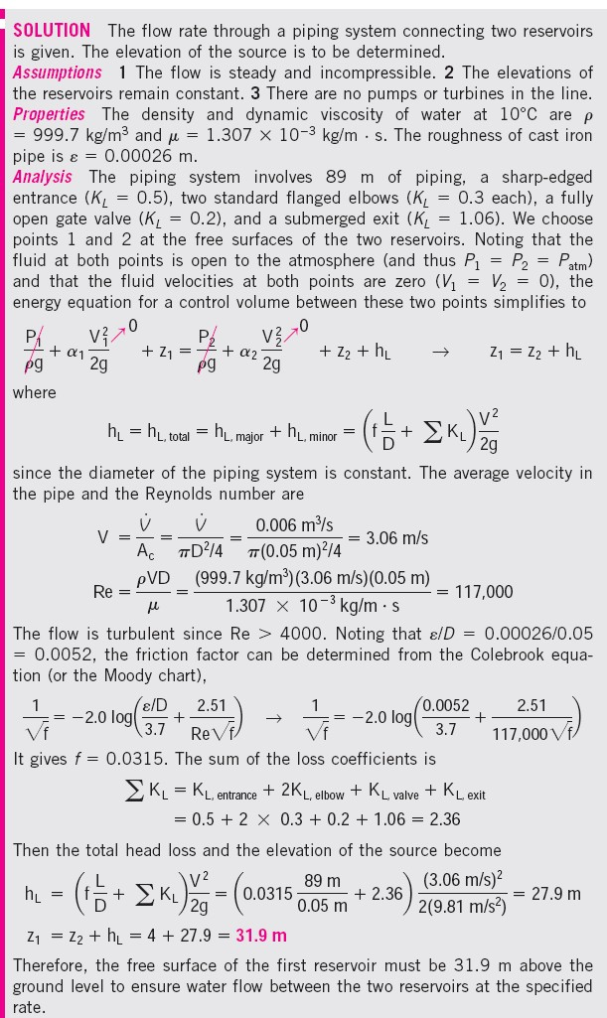
Fluid Mechanics Class Note Dr. Qassem Hamed Jalut Associate Professor
Solution:

Slide 29
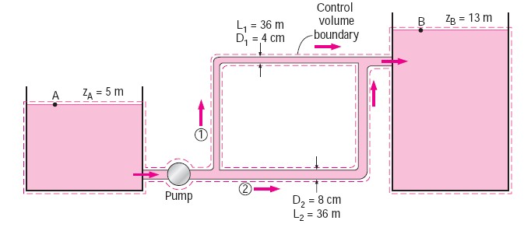
Fluid Mechanics Class Note
Dr. Qassem Hamed Jalut Associate Professor
EXAMPLE 2: Pumping Water through Two Parallel Pipes
Water at 20°C is to be pumped from a reservoir (zA ! 5 m) to another reservoir
at a higher elevation (zB ! 13 m) through two 36-m-long pipes connected in parallel, as shown in Fig. 8–47. The pipes are made of commercial steel, and the diameters of the two pipes are 4 and 8 cm. Water is to be pumped by a 70 percent efficient motor–pump combination that draws 8 kW of electric power during operation. The minor losses and the head loss in pipes that connect the parallel pipes to the two reservoirs are considered to be negligible. Determine the total flow rate between the reservoirs and the flow rate through each of the parallel pipes.
SOLUTION The pumping power input to a piping system with two parallel pipes is given. The flow rates are to be determined.
140

Slide 30
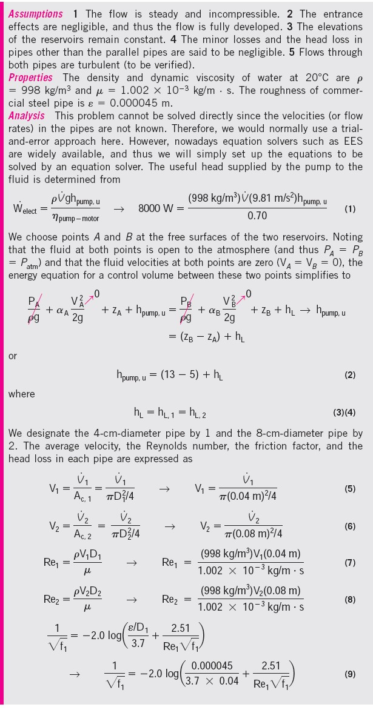
Fluid Mechanics Class Note Dr. Qassem Hamed Jalut Associate Professor

Slide 31
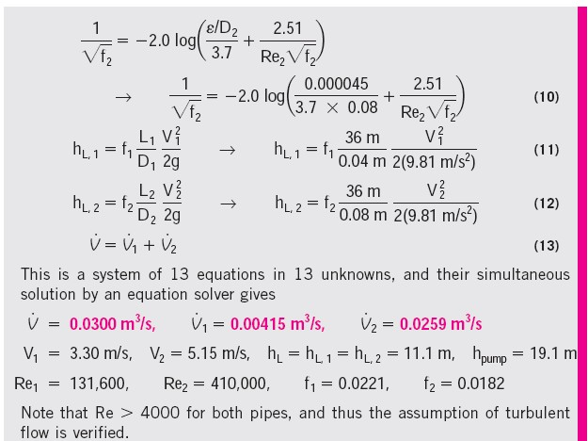
Fluid Mechanics Class Note
Dr. Qassem Hamed Jalut Associate Professor

